Slide 1
Module 1
Module 2
Module 3
Module 4
GUN | NOM
DUB | WAR
HOW | WAR
NOM | WET
DUB | WET
FRO | GUN
FRO | WHO
HOW | PIE
NIX | PIE
NIX | WHO
ARM | BIO
ARM | DUB
ARM | ELF
ARM | NOM
ARM | WET
BIO | ELF
BIO | JOY
BIO | NOM
BIO | RAD
BIO | SPY
DUB | ELF
ELF | GAL
ELF | HOW
ELF | NOM
ELF | PIE
ELF | RAD
ELF | SPY
ELF | WAR
ELF | WET
FRO | RAW
GAL | HOW
GAL | PIE
GAL | RAD
GAL | WAR
GUN | JOY
GUN | RAW
GUN | SPY
GUN | WHO
JOY | NOM
JOY | RAW
JOY | SPY
LEG | NIX
LEG | OVA
LEG | RAW
LEG | SPY
LEG | WHO
NIX | OVA
NIX | SPY
NOM | SPY
OVA | PIE
OVA | RAD
OVA | SPY
PIE | RAD
PIE | SPY
RAD | SPY
RAW | SPY
RAW | WHO
SPY | WHO
GUN | NOM
HIT | NOM
HIT | SUN
IVY | SUN
ETA | TUX
BAH | CIS
BAH | ETA
CIS | OFF
GUN | OFF
IVY | TUX
ASK | GUN
ASK | OFF
ASK | ORC
ASK | TAG
ASK | TUB
BAH | BOY
BOY | CIS
BOY | ETA
BOY | FOX
BOY | ORC
BOY | TAG
CIS | ETA
CIS | ORC
CIS | TAG
DIG | DUI
DIG | GUN
DIG | HIT
DIG | NOM
DIG | TUB
DUI | GUN
DUI | HIT
DUI | IVY
DUI | NOM
DUI | SKY
DUI | SUN
DUI | TAG
DUI | TUB
ETA | FOX
ETA | IVY
ETA | TAG
FOX | IVY
FOX | SKY
FOX | TAG
FOX | TUX
GUN | TAG
GUN | TUB
IVY | SKY
IVY | TAG
OFF | ORC
OFF | TAG
ORC | TAG
SKY | SUN
SKY | TAG
SKY | TUB
TAG | TUB
GYM | TAX
FLY | OIL
OIL | RUM
FLY | TAX
GYM | LID
LID | WAX
RUM | SIP
SIP | WAX
AGO | ALA
AGO | FLY
AGO | GUT
AGO | MIX
AGO | MOM
AGO | OAR
AGO | OIL
AGO | TAX
AIM | EGO
AIM | LID
AIM | MIX
AIM | MOM
AIM | WAX
ALA | FLY
ALA | GUT
ALA | INK
ALA | MIX
ALA | OIL
EGO | GYM
EGO | LID
EGO | MOM
EGO | OAR
FLY | OAR
GUT | HEX
GUT | INK
GUT | MAY
GUT | MIX
GUT | MOM
GUT | OIL
GUT | RUM
GUT | SIP
GUT | WAX
GYM | MOM
GYM | OAR
HEX | MAY
HEX | MIX
HEX | SIP
HEX | WAX
INK | MAY
INK | OIL
INK | RUM
LID | MOM
MAY | RUM
MAY | SIP
MIX | MOM
MIX | OAR
MIX | WAX
MOM | OAR
MOM | TAX
MOM | WAX
OAR | TAX
OIL | TAX
GYM | TAX
GIN | ICE
BAR | DOG
BED | DOG
BED | ICE
GIN | WIZ
TAX | WIZ
BAR | FLU
BOX | GYM
BOX | HUG
FLU | HUG
BAR | CUP
BED | CUP
BED | DAY
BED | GIN
BED | PAW
BED | SAY
BOX | VAN
CUP | DAY
CUP | DOG
CUP | FLU
CUP | GYM
CUP | HUG
CUP | PAW
CUP | VAN
DAY | GIN
DAY | GYM
DAY | PAW
DAY | SAY
DAY | TAX
DAY | ZIG
DOG | PAW
FLU | VAN
GIN | SAY
GIN | TAX
GYM | HUG
GYM | PAW
GYM | VAN
GYM | ZIG
HUG | VAN
ICE | SAY
PAW | SAY
PAW | VAN
PAW | ZIG
SAY | TAX
SAY | WIZ
SAY | ZIG
TAX | ZIG

Slide 2
Module 5
Module 6
Module 7
Module 8
FLY | OIL
OIL | RUM
DUB | WAR
HOW | WAR
JUG | PLY
PLY | VOW
NIL | TOY
DUB | TOY
FLY | VOW
HOW | RUM
JUG | NIL
ADO | BOA
ADO | DUB
ADO | HOW
ADO | JOB
ADO | NAY
ADO | NIL
ADO | PLY
ADO | REF
ADO | TOY
ADO | WAR
BOA | HOW
BOA | NAY
BOA | REF
BOA | SHY
BOA | WAR
DRY | FLY
DRY | FUN
DRY | OIL
DRY | REF
DRY | SHY
DRY | VOW
FUN | NAY
FUN | PLY
FUN | REF
FUN | VOW
HOW | REF
HOW | WHY
JOB | JUG
JOB | NAY
JOB | NIL
JOB | PLY
JOB | TOY
NAY | PLY
NAY | REF
NIL | PLY
OIL | REF
OIL | SHY
OIL | VOW
PLY | REF
REF | RUM
REF | SHY
REF | VOW
RUM | SHY
JUG | PLY
PLY | VOW
GIN | ICE
ACT | LAX
ERA | RIB
FOG | RIB
FOG | TAU
ACT | TAU
ERA | JUG
GIN | VOW
ICE | LAX
ACT | DUH
ACT | HAM
ACT | NAN
ACT | SOY
ACT | TRY
DUH | HAM
DUH | MOP
DUH | NAN
DUH | SOY
DUH | TRY
ERA | PLY
ERA | SOY
FAN | MOP
FAN | NAN
FAN | PLY
FAN | VOW
FAN | ZZZ
FOG | SOY
FOG | TRY
GIN | HAM
GIN | LAX
GIN | NAN
GIN | ZZZ
HAM | ICE
HAM | LAX
HAM | NAN
HAM | ZZZ
JUG | MOP
JUG | RIB
JUG | SOY
LAX | NAN
MOP | NAN
MOP | PLY
MOP | SOY
NAN | PLY
NAN | SOY
NAN | VOW
NAN | ZZZ
PLY | SOY
RIB | SOY
SOY | TAU
SOY | TRY
TAU | TRY
VOW | ZZZ
NIL | TOY
HIT | NOM
HIT | SUN
IVY | SUN
NOM | WET
FIX | MAC
ERA | IRE
ERA | NIL
FIX | IVY
IRE | MAC
TOY | WET
ACE | BRO
ACE | EON
ACE | EYE
ACE | FIX
ACE | HIT
ACE | IVY
ACE | NOM
ACE | POP
ACE | SUN
ACE | WET
ACE | YES
AHI | EON
AHI | ERA
AHI | IRE
AHI | NIL
AHI | YES
BRO | EON
BRO | HIT
BRO | NOM
BRO | WET
EON | NIL
EON | POP
EON | TOY
EON | WET
EON | YES
ERA | YES
EYE | FIX
EYE | IVY
EYE | POP
EYE | SUN
FIX | POP
FIX | YES
IRE | YES
MAC | POP
MAC | YES
NIL | WET
NIL | YES
POP | YES
WET | YES
ETA | TUX
AMP | SEX
KEG | LUG
KEG | TAR
PHI | TAR
AMP | YAY
BAM | ETA
BAM | YAY
LUG | TUX
PHI | SEX
AMP | SAW
BAM | HAY
BAM | JAR
BAM | WIN
ETA | JAR
ETA | LUG
ETA | PAY
ETA | WIN
HAY | JAR
HAY | SAW
HAY | WIN
HAY | YAY
JAR | LUG
JAR | PAY
JAR | SAW
JAR | TAR
JAR | WHY
JAR | WIN
JAR | YAY
KEG | WHY
LUG | PAY
LUG | TAR
LUG | WHY
PAY | TUX
PAY | WHY
PAY | WIN
PHI | SAW
SAW | SEX
SAW | TAR
SAW | WHY
SAW | YAY
SEX | TAR
SEX | YAY
TAR | WHY
TAR | YAY

Slide 3
COP | WOW
AMP | SEX
GOO | PIG
AMP | CAB
CAB | GET
COP | GET
EAR | PIG
EAR | SEX
GOO | WOW
ALL | EGG
ALL | GOO
ALL | PIG
ALL | RUG
ALL | SAD
AMP | ROB
CAB | DAD
CAB | OAK
CAB | ROB
CAB | SEX
COP | NEW
DAD | EAR
DAD | EGG
DAD | FOR
DAD | GEL
DAD | GET
DAD | MOO
DAD | OAK
DAD | PIG
DAD | ROB
DAD | RUG
DAD | SEX
EAR | GEL
EAR | MOO
EGG | FOR
EGG | MOO
EGG | PIG
EGG | RUG
FOR | GET
FOR | HIP
FOR | OAK
FOR | RUG
GEL | MOO
GEL | ROB
GEL | SEX
GET | HIP
GET | NEW
GET | OAK
GET | RUG
GET | WOW
GOO | RUG
GOO | SAD
HIP | NEW
HIP | RUG
HIP | SAD
HIP | WOW
MOO | PIG
NEW | WOW
OAK | ROB
PIG | RUG
ROB | SEX
RUG | SAD
RUG | WOW
SAD | WOW
Module 10
Module 9
Module 11
Module 12
BAR | DOG
BED | DOG
COP | WOW
BED | COY
COY | NOR
KEY | NOR
BAR | SIR
COP | TAT
KEY | WOW
SIR | TAT
AGE | BAR
AGE | BED
AGE | CHI
AGE | COY
AGE | DOG
AGE | ELK
AGE | KIT
AGE | ONO
AGE | SIR
BAR | ONO
BED | CHI
CHI | COY
CHI | DOG
CHI | KIT
COP | ELK
COP | USE
COY | ELK
COY | KIT
ELK | KIT
ELK | NOR
ELK | ONO
ELK | SIR
ELK | TAT
ELK | USE
ELK | WIG
ELK | WOW
KEY | WIG
KIT | NOR
KIT | ONO
KIT | WIG
NOR | WIG
NOR | WOW
ONO | SIR
ONO | TAT
ONO | USE
TAT | USE
USE | WIG
USE | WOW
WIG | WOW
KEG | LUG
KEG | TAR
PHI | TAR
FIX | MAC
JAM | LIE
GIG | LIE
EAR | JAM
EAR | PHI
FIX | GAS
GAS | LUG
GIG | MAC
AIR | COW
AIR | FAX
AIR | FIX
AIR | GIG
AIR | MAC
AIR | ODD
COW | EAR
COW | FAX
COW | FIX
COW | GIG
COW | KEG
COW | LIE
COW | LUG
COW | ODD
COW | TAR
COW | WAS
COW | ZOO
EAR | LIE
EAR | TAR
EAR | WAS
EAR | ZOO
FAX | GIG
FAX | LIE
FAX | ZOO
FIX | GIG
FIX | LUG
FIX | ODD
GAS | ODD
JAM | ZOO
KEG | ODD
KEG | WAS
LIE | ZOO
LUG | ODD
PHI | WAS
TAR | WAS
WAS | ZOO
BED | COY
COY | NOR
KEY | NOR
ACT | LAX
GOO | YAK
LAB | YAK
ACT | LAM
BED | LAX
GOO | KEY
LAB | LAM
ACT | ASH
ACT | BUG
ART | ASH
ART | BUG
ART | COY
ART | FIG
ART | LAX
ART | MAD
ART | NOR
ASH | BUG
ASH | LAM
ASH | LAX
BED | MAD
BUG | COY
BUG | FIG
BUG | GOO
BUG | LAB
BUG | LAM
BUG | LAX
BUG | NOR
BUG | YAK
COY | LAX
COY | MAD
FIG | GOO
FIG | KEY
FIG | NOR
FIG | YAK
GOO | NOR
LAX | MAD

Slide 4
Module 13
GOO | YAK
LAB | YAK
JAM | LIE
GOO | PIG
LIE | OLD
LIE | TAU
OLD | TAU
JAM | PIG
LAB | TAU
GOO | PRO
GOO | ZAP
HOT | JAM
HOT | LIE
HOT | OLD
HOT | PIG
HOT | PRO
HOT | ZAP
LAB | OLD
LAB | ZAP
LIE | PIG
LIE | ZAP
OLD | ZAP
PIG | PRO
PIG | ZAP
PRO | YAK
PRO | ZAP
TAU | ZAP
YAK | ZAP
Module 14
LIE | OLD
LIE | TAU
OLD | TAU
GIG | LIE
ERA | IRE
ERA | RIB
FOG | RIB
FOG | TAU
GIG | IRE
ERA | GIG
ERA | LAW
EVE | FOG
EVE | GIG
EVE | IRE
EVE | LAW
EVE | LIE
EVE | OLD
FOG | OLD
GIG | LAW
IRE | LAW
IRE | RIB
LAW | LIE
LAW | OLD
LAW | RIB
LAW | TAU

Slide 5
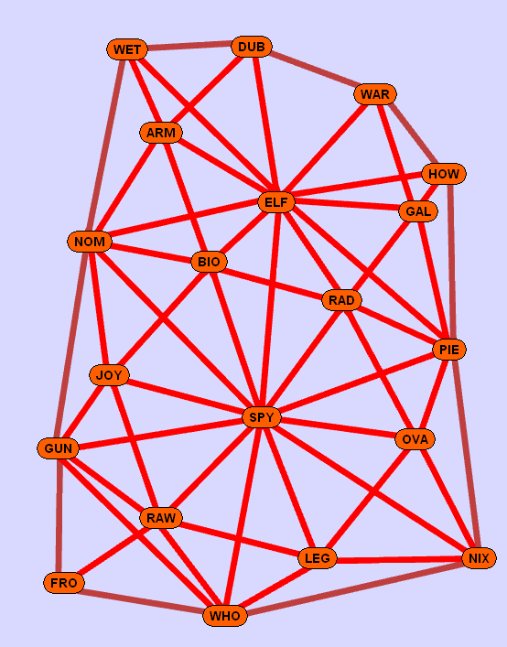
Module 1

Slide 6
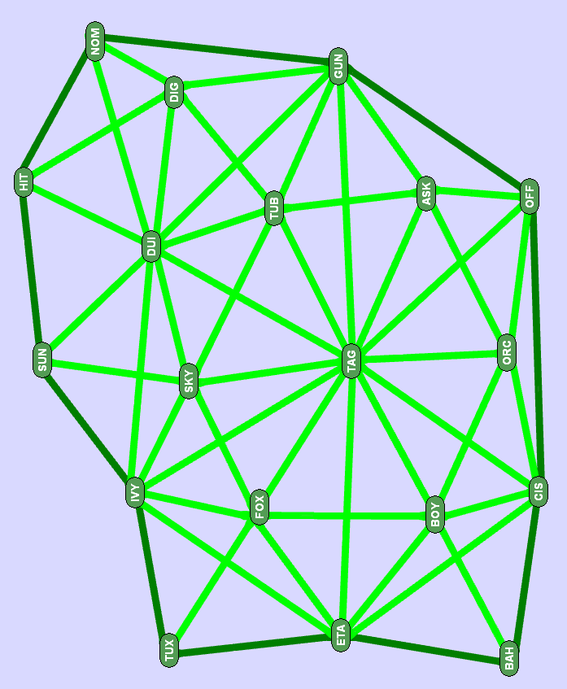
Module 2

Slide 7
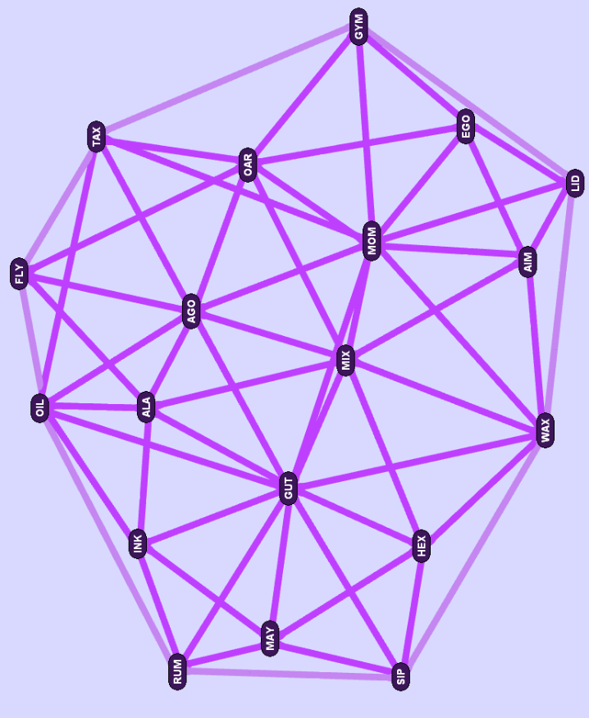
Module 3

Slide 8
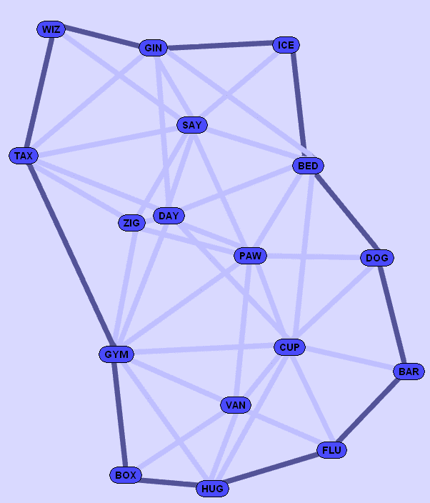
Module 4

Slide 9
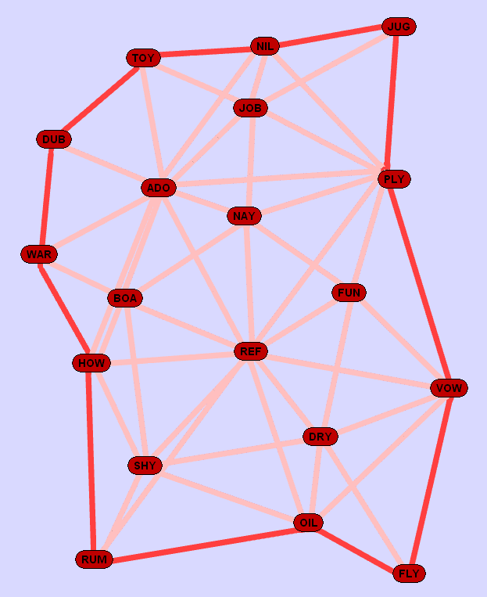
Module 5

Slide 10
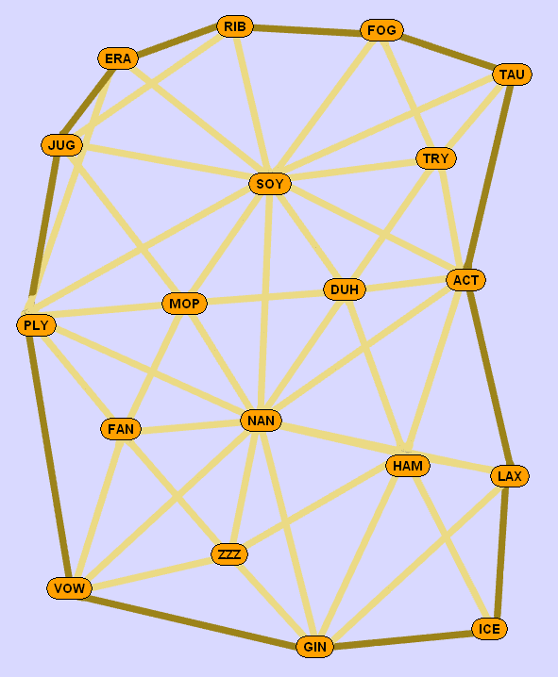
Module 6

Slide 11
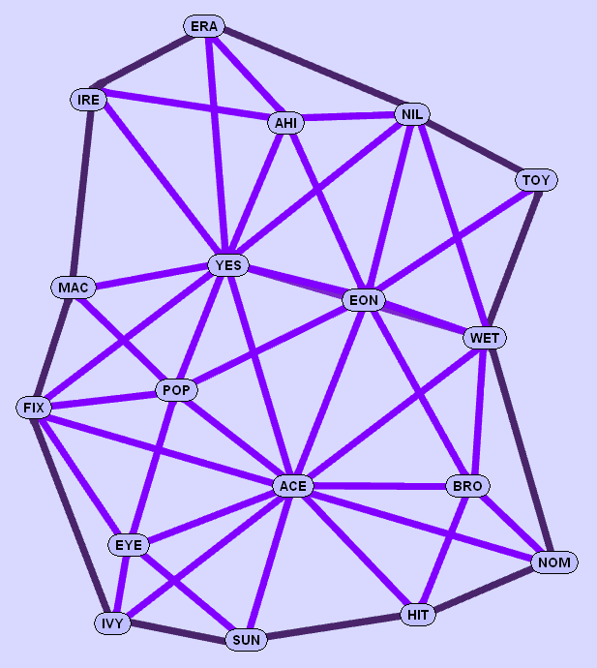
Module 7

Slide 12
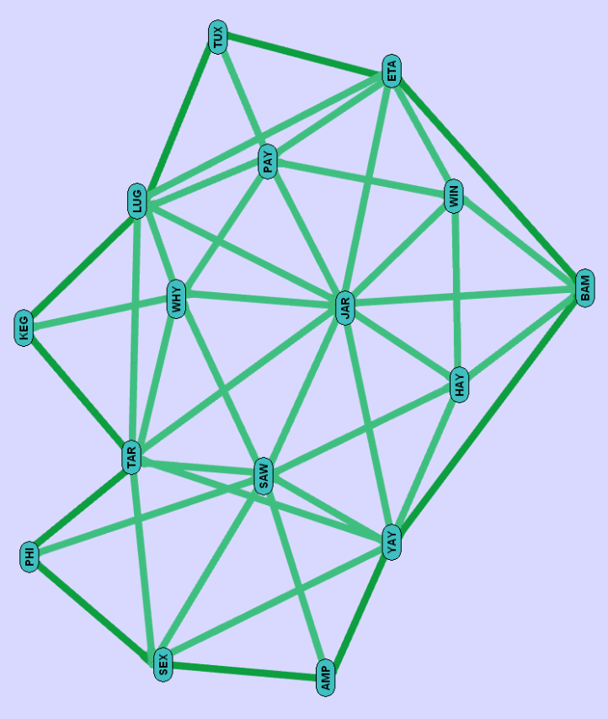
Module 8

Slide 13
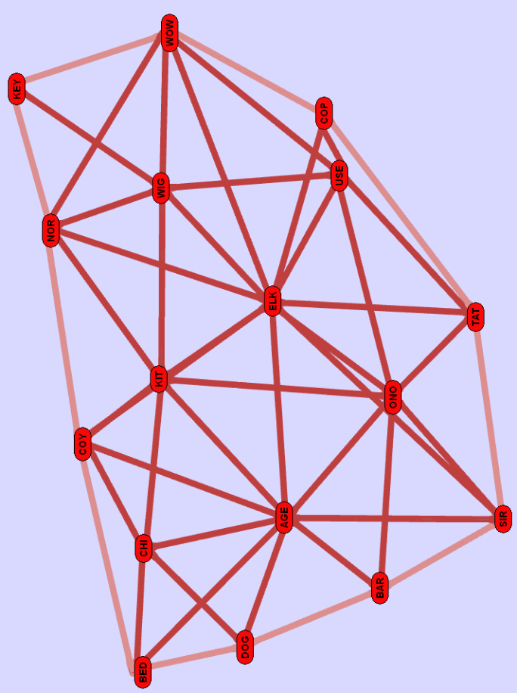
Module 9

Slide 14
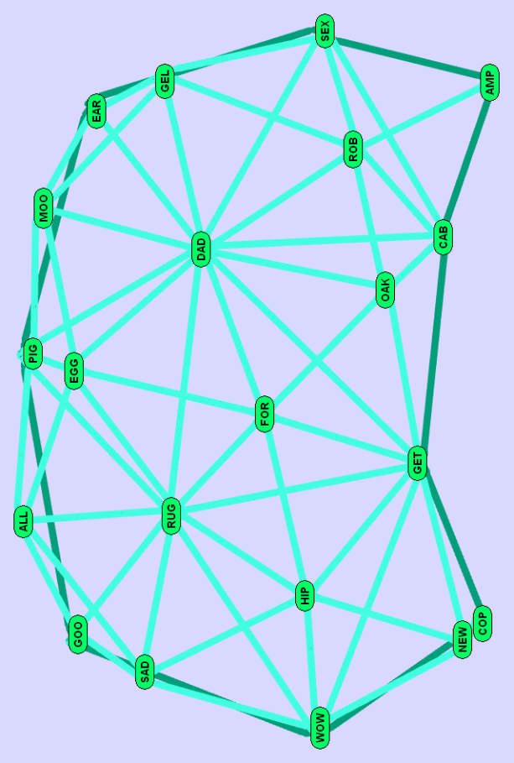
Module 10

Slide 15
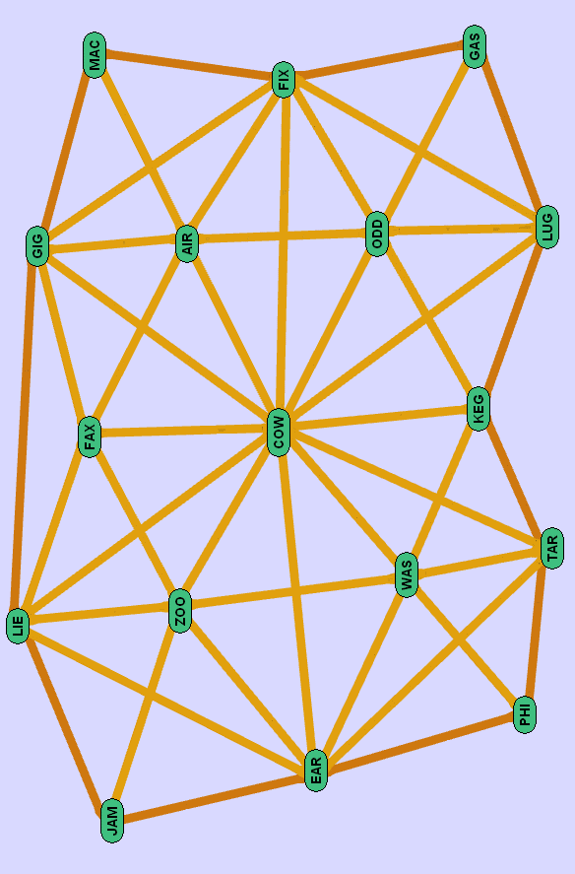
Module 11

Slide 16
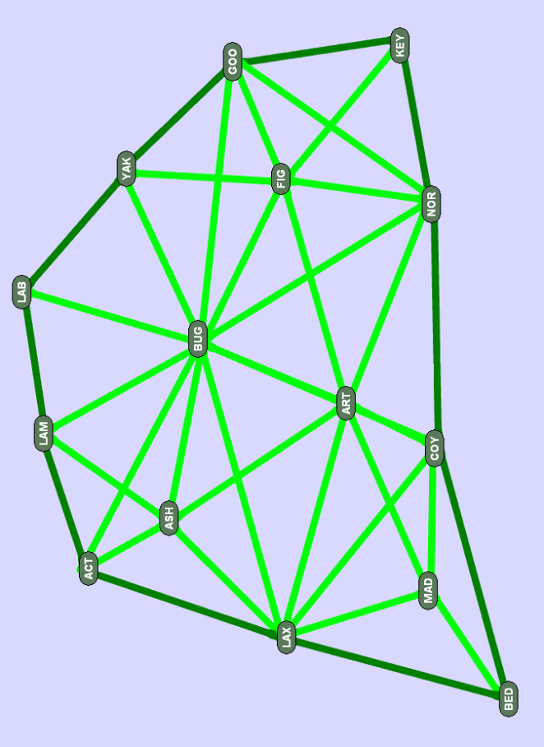
Module 12

Slide 17
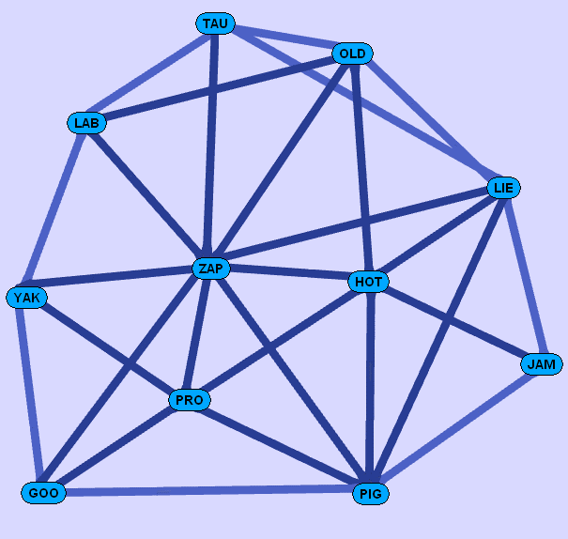
Module 13

Slide 18
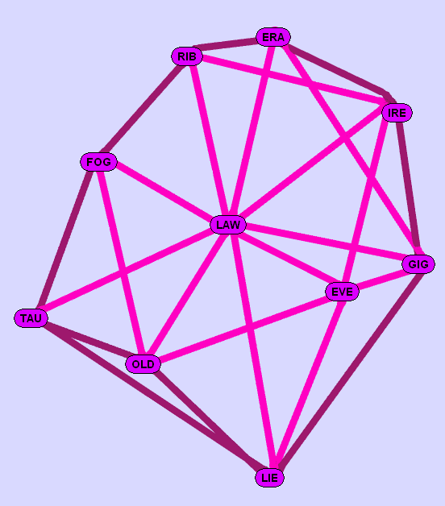
Module 14

